Slide 1
Capstone 1
Project: Using Convolutional Neural Networks (CNN) to estimate population from aerial images
By: Mahdi Ashraf
Springboard Data Science Career Track

Slide 2
Proposal
Train a neural network that learns to estimate the size of populous captured over aerial expanses
Supervised learning task of associating settlement features to population densities
Beneficiaries: government agencies, civic authorities, relief organizations
Purpose: provide real-time estimates in the absence of reliable census
Benchmark: None, novel proposal
Requirements:
High Quality Satellite or Aerial Images
Population labels w.r.t Images

Slide 3
Population Labels
European Space Agency (ESA)
Dataset: Geo-tiff image that maps pixel intensities to population labels
Advantages:
Robust and flexible allowing rapid querying of labels
“Geo-tag” allows seamless integration with the aerial images
Disadvantages:
Cannot guarantee precision of data. Better for qualitative representations
Created in 2015, will lose relevancy over time

Slide 4
Aerial Images
Dataset: Novel, generated using Google Earth & QGIS
Original Set: 7500 images Post-Augmentation: 34,000 images
Dimensions: 400x400x3
Advantages:
Exceptionally high-resolution imagery not available from public repos
No commercial vendors required acquire images
Disadvantages:
Memory intensive. Dataset requires 16GB of memory after being zipped.
Difficult to expand dataset as examples need to be manually created
May not be up-to-date as compared to commercial sources

Slide 5
Model Neural Network (CNN)
Implemented with Keras
Fully-Connected CNN with 2 Convolutional layers and 1 Dense Layers
Input: Aerial Images | Target: Population labels | Predictions: Population estimate
Advantages:
Keras high functional library – quick implementations
CNNs capture features invariant to spatiality
Disadvantages:
Single GPU can be underwhelming owing to the high-resolution images
Restrictions to model depth and batch size due to large training images
Training requires long periods of time

Slide 6
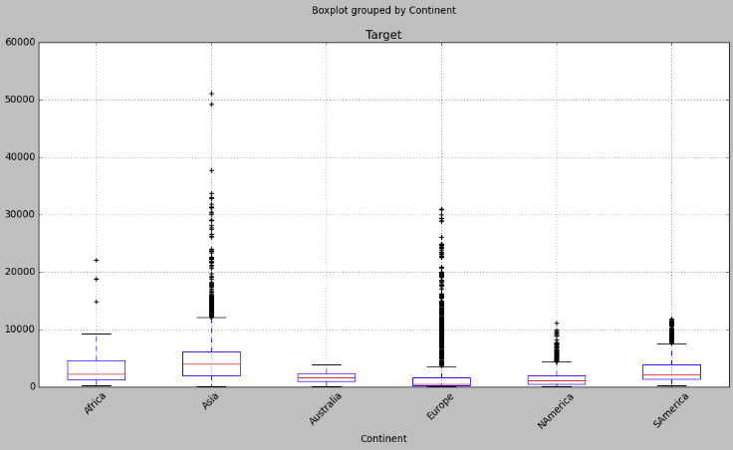
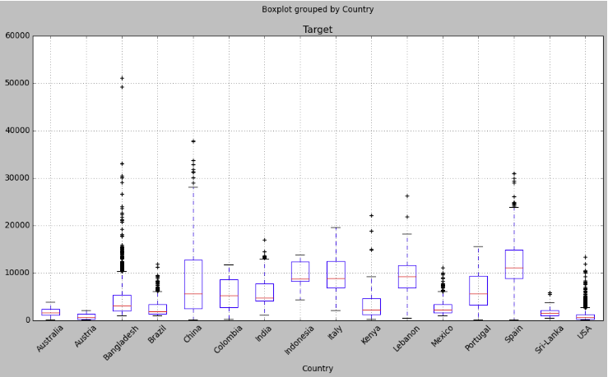
Data Review
Extends over all seven continents
Acquired from 32 cities across 14 countries

Slide 7
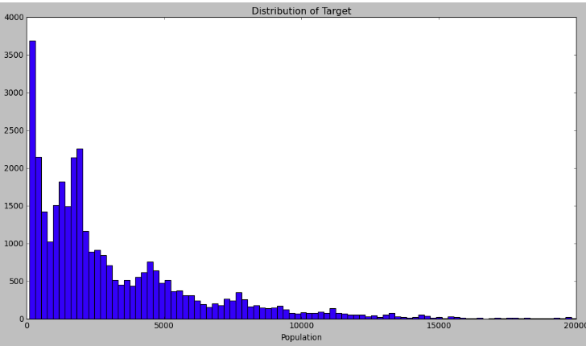
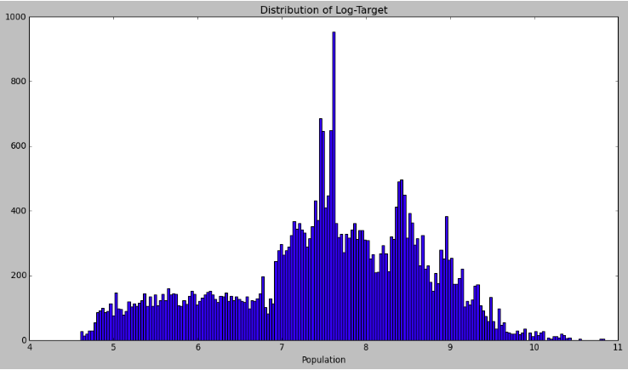
Data Review
34,000 pair of training images and labels

Slide 8
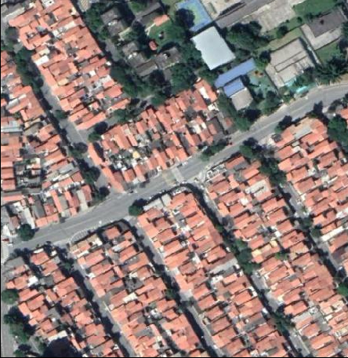
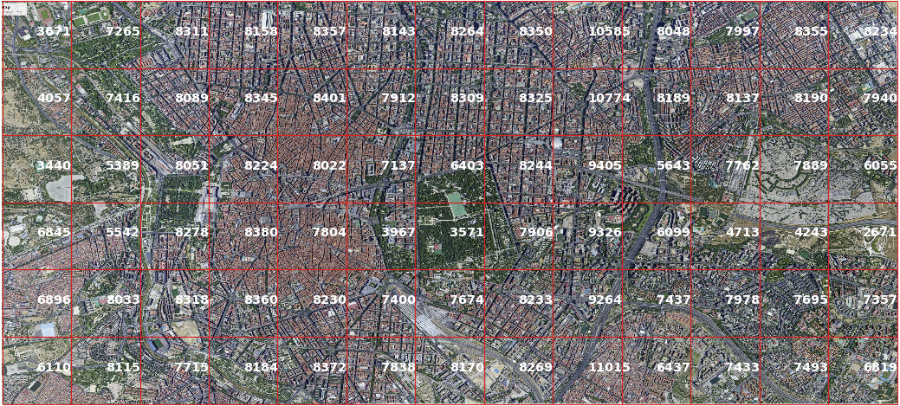
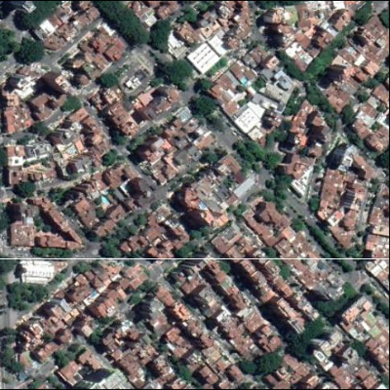
Data Review
Images from Dataset - (Left) Post extraction (Right) Pre extraction

Slide 9
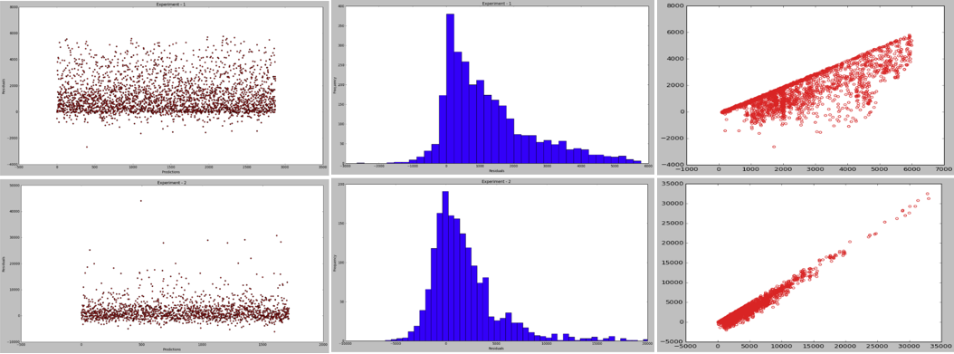
Results
Model suffers due to the log-normal distribution of target labels. Proposed clipping of target data to improve performance.
Model Accuracy ~ within 56% of target population with no clipping for any prediction
~ within 72% of target population after clipping extreme values for any prediction

Slide 10
Conclusions & Future Work
Acquire images directly from a commercial source
Significantly expand the dataset and circumvent manual data generation
Promising Direction:
Feature engineering can help to alleviate the non-unique distribution owing from the various places the data is acquired
Features can be GDP, Mortality, Demographics etc.
Simultaneously implement experiment that incorporates CNN + text features in a single model
Final Outlook:
Very positive. Objective was met and a novel solution was provided even when data was unavailable
Novel implementation. Designed the experiment end-to-end from getting labels, assigning them and creating the images

